Slide 1


Slide 2
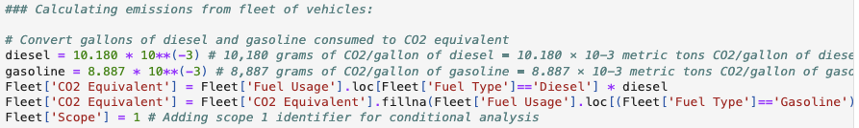


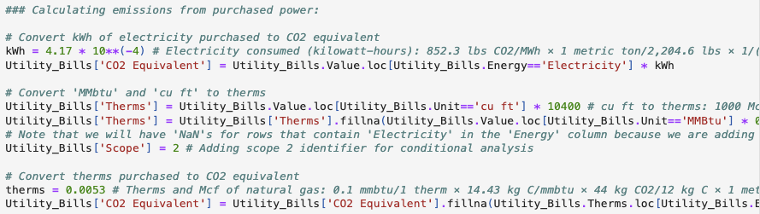
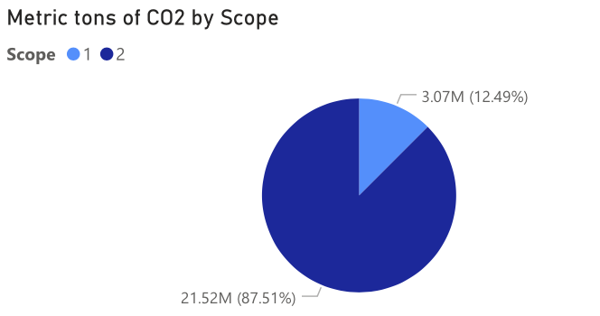
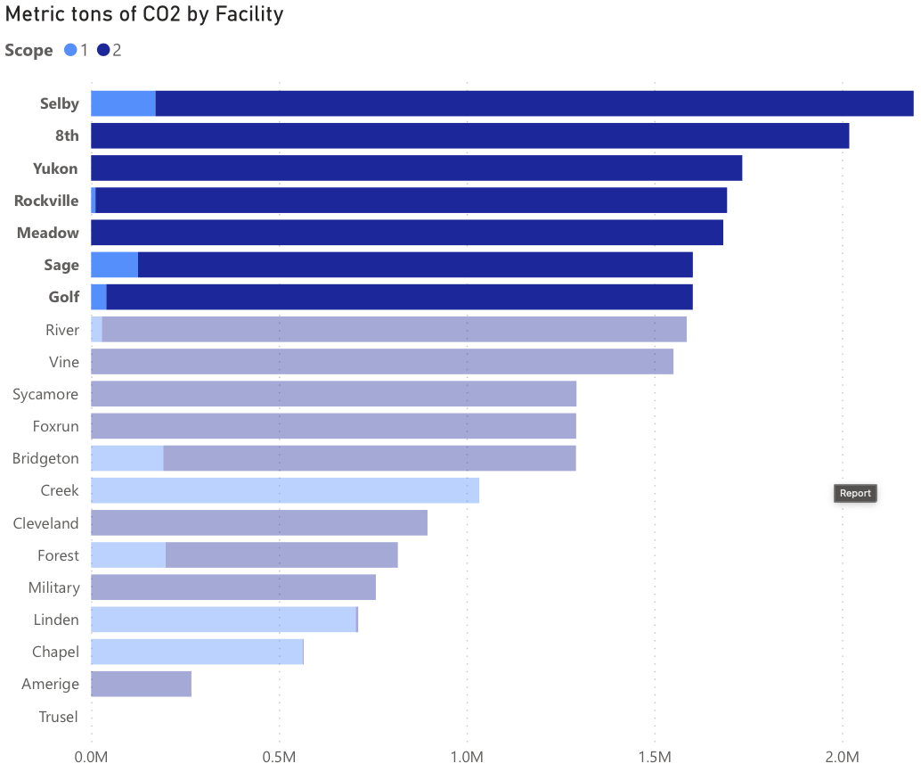
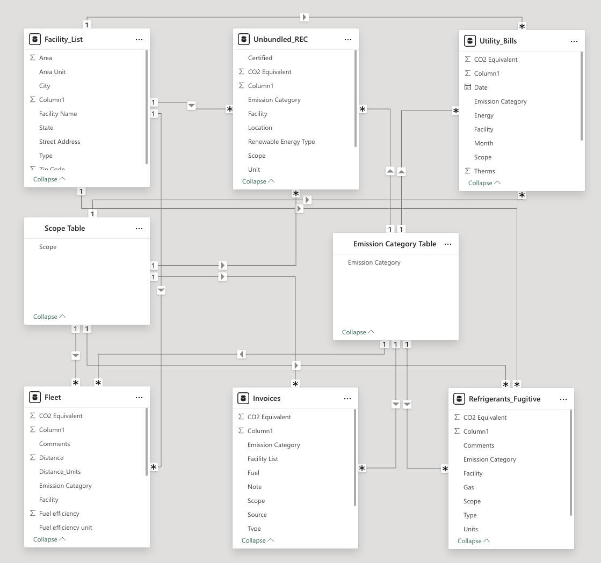
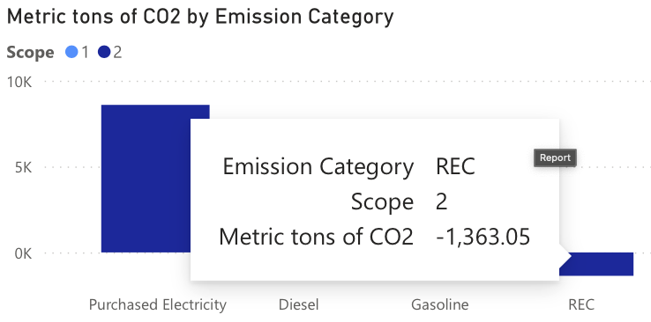
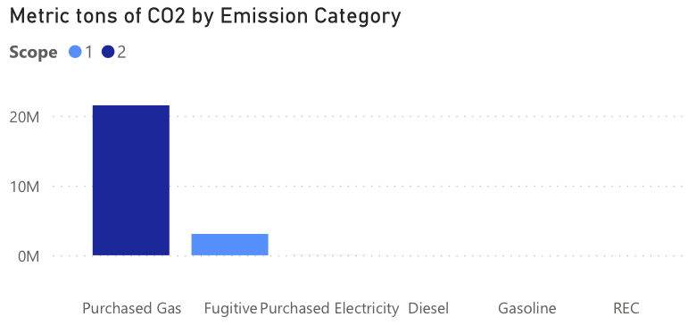
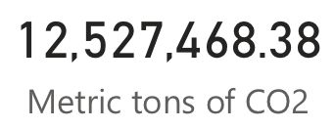
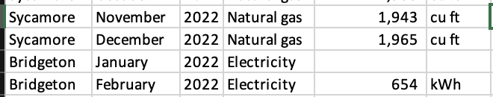
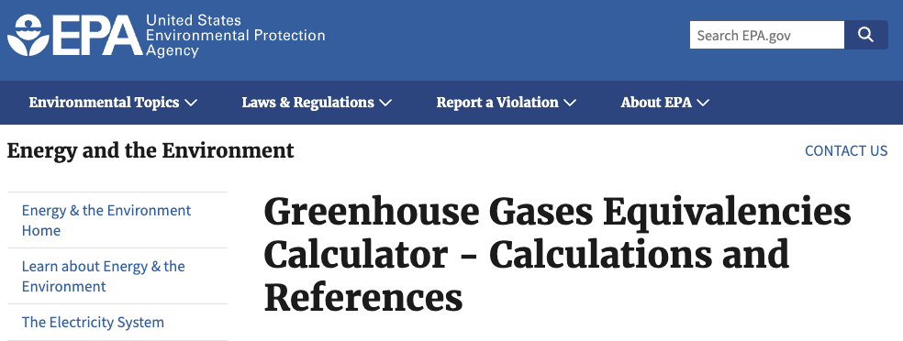
Key Considerations and Findings
Overall quality of data for GHG inventory
Useable, but there is missing data* in Utility Bills. We will assume no energy purchases were made during those times. If this is wrong, please let us know so we can re-evaluate!
Data exists in individual silos rather than in a centralized, integrous, and accessible location.
Priorities to improve quality of GHG inventory
Set up a database rather than working with individual excel sheets.
Set up data quality checks for overall process improvement.
We have carried this out via the process depicted here →
Analysis of GHG inventory results
Scope 2 accounts for over 80% of emissions (Fig. 1)
Purchased Gas is the most impactful emission category, followed by Fugitives (Fig. 2)
7 facilities account for ~half of GHG emissions (Shelby, 8th, Yukon, Rockville, Meadow, Sage, and Golf) [Fig. 3]
Opportunities for GHG emission reductions
Reduce purchased gas (Fig. 2) and fugitives at Creek, Linden, and Chapel facilities (showcase interactive visuals!)
Invest in more RECs (Fig. 4), and maybe better management for Linden & Chapel (showcase interactive visuals!)
Clean Raw Data
Calculate CO₂ Equiv.
* calculations & data transformations →
Sources:
Store in a usable database
Visualize key findings
* database
* database (Power BI data model)
(Fig. 1)
(Fig. 3)
(Fig. 4)
(Fig. 2)
* missing utility statement data
Github with code and calculations:
https://github.com/jsilver1/Job-Interviews/tree/main/Mock%20GHG%20Inventory
Full report notebook: https://github.com/jsilver1/Job-Interviews/blob/main/Mock%20GHG%20Inventory/GHG%20Inventory%20for%20No%20Name%20SemiChip%20Co.ipynb
Sources:
https://www.epa.gov/energy/greenhouse-gases-equivalencies-calculator-calculations-and-references
https://ww2.arb.ca.gov/resources/documents/high-gwp-refrigerants
https://ghgprotocol.org/sites/default/files/ghgp/Global-Warming-Potential-Values%20%28Feb%2016%202016%29_1.pdf

